Slide 1
Basic HTML and CSS
by Kate Nicolson

Slide 2
HTML

Slide 3
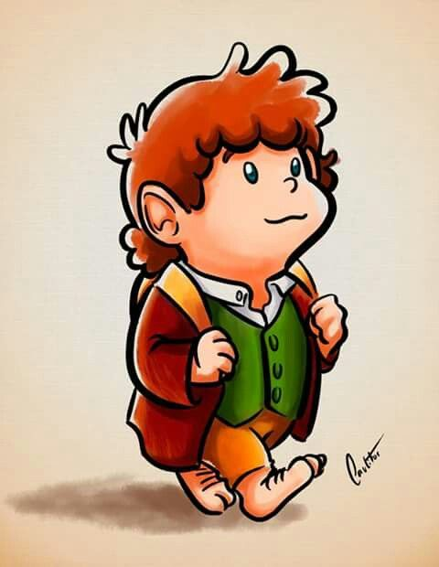
Why?
First lets start with the scenario that you want to make a profile page for someone.
Now choose a person, real or fake, fact or fictional as long as you know enough about them to write some details.
I Choose Bilbo

Slide 4
Next the Profile
Bilbo Baggins
Info:
Date of Birth: 10/10/1925
Gender: Male
Address: Bag-end, Bagshot Row, Hobbiton, Shire.
Hobbies:
Smoking Pipe
Adventuring
Climbing
Saving the World
Reading Fantasy Fiction.
So please type up the information you know about your person or character in a text editor.
This can be in Word, Notepad, Notepad++, whichever you feel comfortable with
I would like:
Name, a/s/l and thier hobbies.
See Example ----->

Slide 5
Next making it HTML
<!DOCTYPE html>
<html>
<head>
<title> Profile <title>
</head>
<body>
Bilbo Baggins
Info:
Date of Birth: 10/10/1925
Gender: Male
Address: Bag-end, Bagshot Row, Hobbiton, Shire.
Hobbies:
Smoking Pipe
Adventuring
Climbing
Saving the World
Reading Fantasy Fiction.
</body>
</html>
To tell the computer that this is a webpage please
Save As .html document
Or Save and change .txt to .html
____________________________
Then add the following:

Slide 6
MarkUp
<!DOCTYPE html>
<html>
<head>
<title> Profile <title>
</head>
<body>
Bilbo Baggins
Info:
Date of Birth: 10/10/1925
Gender: Male
Address: Bag-end, Bagshot Row, Hobbiton, Shire.
Hobbies:
Smoking Pipe
Adventuring
Climbing
Saving the World
Reading Fantasy Fiction.
</body>
</html>
So you can see that there are now sections to the document
anywhere that starts with <###> and finishes with </###> is a section
You can see that they are nested is some cases like the head and body, or how <html> </html> contains main content of the page.
This is how we tell the page to organise and catergorise itself.

Slide 7
Lets see how that looks.
Save and open with a browser.

Slide 8
Lets section your text
<body>
<h1>Bilbo Baggins</h1>
<h2>Info: </h2>
<p>
Date of Birth: 10/10/1925 <br>
Gender: Male<br>
Address: Bag-end, Bagshot Row, Hobbiton, Shire.
</p>
<br>
<h3>Hobbies: </h3>
Smoking Pipe
Adventuring
Climbing
Saving the World
Reading Fantasy Fiction.
</body>
Focusing now on what is inside the <body></body> lets allocate some sections.
<h1></h1> Heading
<h2></h2> Sub Heading
<h3></h3> Sub sub Heading
<p></p> Paragraphs
<br> Break

Slide 9
Save and check your website

Slide 10
Next the Pics
<body>
<h1>Bilbo Baggins</h1>
<h2>Info: </h2>
<p>
Date of Birth: 10/10/1925 <br>
Gender: Male<br>
Address: Bag-end, Bagshot Row, Hobbiton, Shire.
</p>
<br>
<img src = “bilbo.jpg” width= “100” height= “200”>
<h3>Hobbies: </h3>
Smoking Pipe
Adventuring
Climbing
Saving the World
Reading Fantasy Fiction.
</body>
Lets add a picture! So in the same folder you saved your html document save an image in that folder.
Then in your code add
<img src = “###.jpg” width= “###” height= “###”>
Height and Width is in Pixels so try different sizes to suit your picture or don’t defiine them so
<img src = “###.jpg” >

Slide 11
Save and check your website

Slide 12
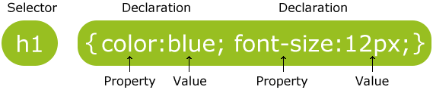
Next CSS
Open a new text document
Save As a .css file in the same folder
And have a play at making your own CSS values.
h1{ color: blue;
background: lightblue;
font-family: arial;
}
p{ color: 008080;
background: 00FFFF;
font-weight: bold;
}

Slide 13
Next connect your HTML and CSS
<!DOCTYPE html>
<html>
<head>
<title> Profile <title>
<link rel= “stylesheet” type= “text/css” href= “bilboCSS.css” >
</head>
<body>
Bilbo Baggins
Info:
...
Hobbies:
...
</body>
</html>
Save you CSS
Now go back to your html document and in the <head> add the following using the name of your CSS file
<link rel=”stylesheet” type = “text/css” href=”###.css”>

Slide 14
Save and check your website

Slide 15
Next Play!
W3Schools: www.w3schools.com
Kuler: color.adobe.com
SoloLearn ‘Learn HTML’ ‘Learn CSS’ mobile apps
Lynda.com ‘HTML Essential Training’
Codeacademy: codeacademy.com/learn/web
Youtube!
HTML & CSS: Design and Build Web Sites
by Jon Duckett
Yes… a book! :)
This is the utter basics, there are lots of CSS elements and formatting options.
There are also ways to create your own sections and ways to make your website expand.
Note these websites for ways to continnue your learning into web development and to get certificates for your LinkedIn

Slide 16

Thanks!
Kate Nicolson
Kate.Nicolson@stu.mmu.ac.uk
Computing Society
facebook.com/groups/MMUComputingSociety
@MMUComputingSoc
Register on theunionmmu.org

